Slide 1
SEP3 – Semester Project 3: Heterogeneous System
Introduction

Slide 2



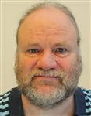

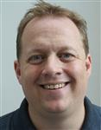
The SEP3 Team
Jakob Knop Rasmussen
jknr@via.dk
A.301a
Line Lindhardt Egsgaard
lile@via.dk
A.304
Christian Flinker Sandbeck
chfs@via.dk
A.304
Jan Munch Pedersen
jpe@via.dk
A.301b
Erland Ketil Larsen
erl@via.dk
A.304
Ole Ildsgaard Hougaard
oih@via.dk
A.301b

Slide 3
3rd Semester Courses
SDJ3
Software Development of Distributed Systems
DNP1
Internet Technologies, C# and .NET
NES1
Networking and Security
CAO (not part of SEP3)
Computer Architecture and Organization
Part of SEP3

Slide 4
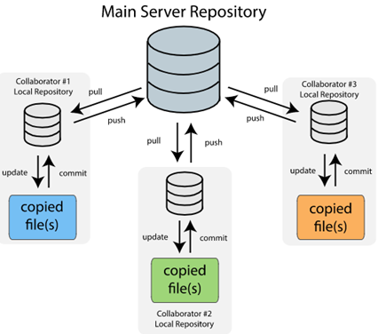

SEP3 Focus
Working as a real software team
Your project should be under version control from start to finish

Slide 5

SEP3 Focus

Slide 6
SEP3 Expectations and Recommendations
Every Thursday in weeks 34-41, 43-51
The last two weeks: spend 40+ hours per week per person
Full workdays (and a few weekends)
Plus 60 hours more
Your primary work environment should be in class

Slide 7
SEP3 Requirements
Based on Course Description
Report has to follow Software Engineering guidelines (and templates)
You have to…
Make a 3-tier architecture
Use Java and C#
Consume and expose a web service
Design and use a protocol for sockets
Create a GUI for each client

Slide 8
Definition: Heterogeneous System
A heterogeneous system involves a variety of technologies. It applies to any of the following:
​Different networks
Different computer hardware
Different operating systems
Different programming languages
Different communication protocols

Slide 9
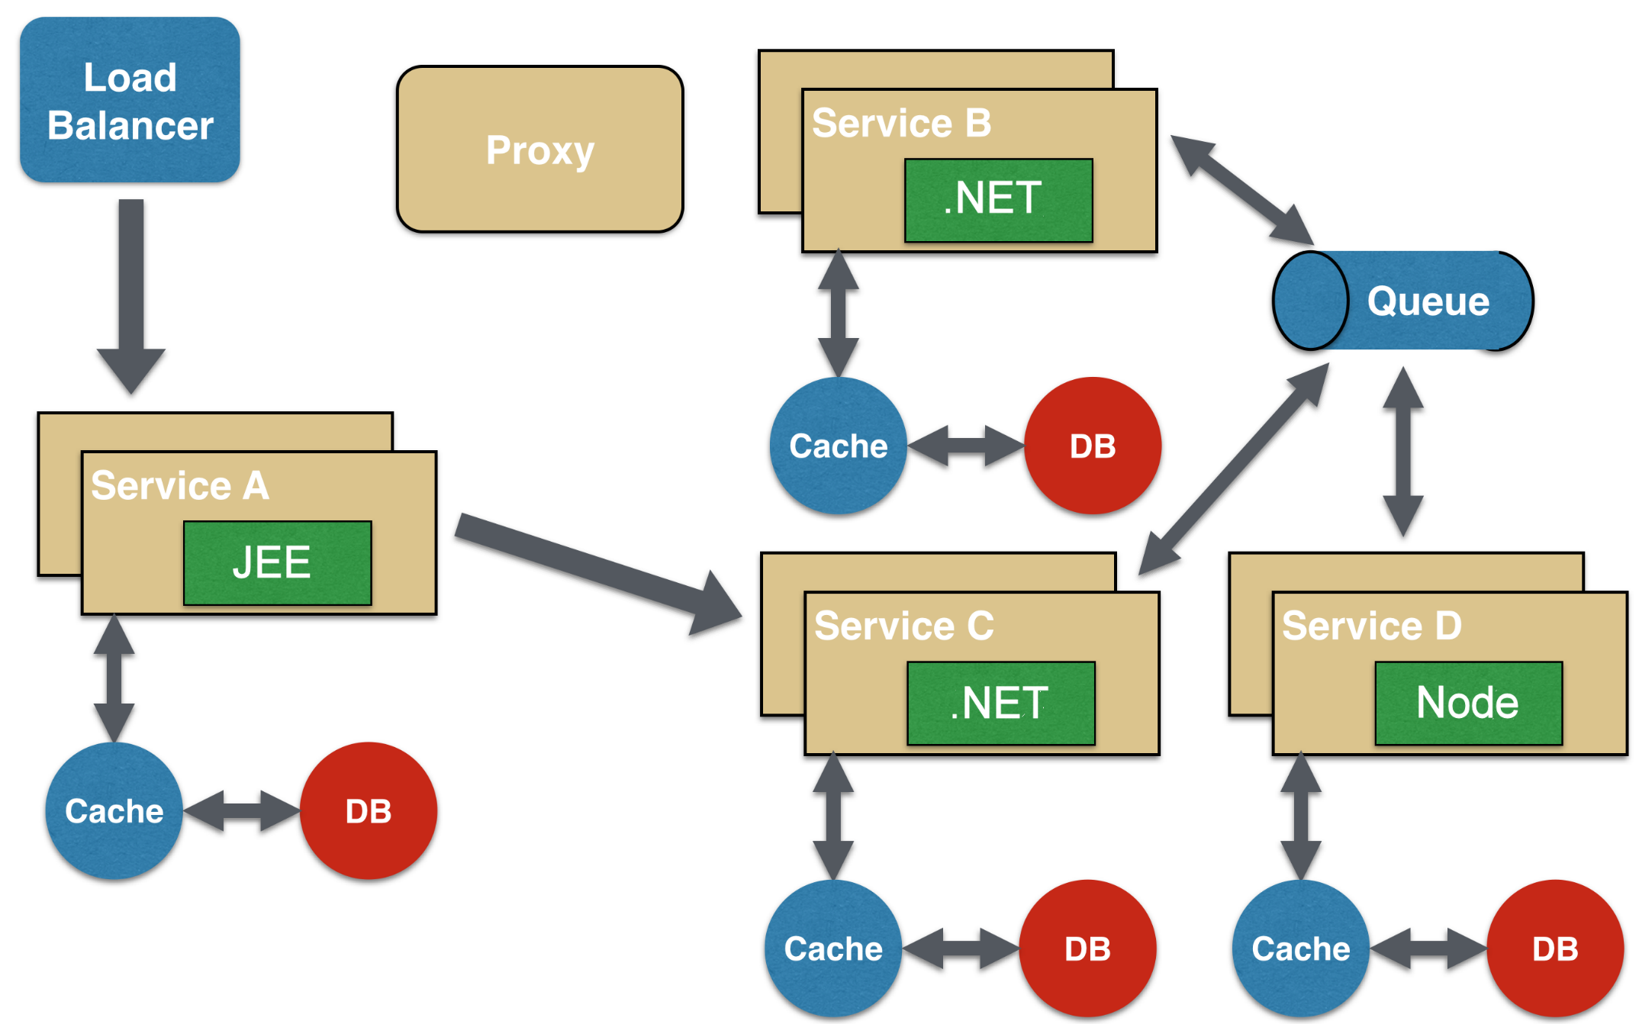
Heterogenous System

Slide 10
SEP3 Plan
Week
34 | Team and Semester Introduction |  | 43
35 |  |  | 44
36 | DEADLINE: Group Formation + Project Proposal |  | 45
37 |  |  | 46 | DEADLINE: Proof of Concept
38 | DEADLINE: Project Description Draft |  | 47
39 | DEADLINE: Project Description Final |  | 48
40 | Guest Lecture: “What is continuous delivery and why is it so important?” |  | 49
41 | DEADLINE: Architecture |  | 50
42 | Autumn Break |  | 51 | DEADLINE: Final Project Hand-in, Wednesday 19/11, 12:00 noon
On Thursdays: You can find us in our offices
(at least until noon)
Deadlines Thursday 23.59
(except final hand-in)

Slide 11

Exam Info
Oral Examination
Joint exam with SDJ3 and DNP1
Group presentation followed by individual examination
Group presentation of the project - 5 minutes per person
Individual examination - 35 minutes (including examination in SDJ3 and DNP1)

Slide 12
Group Formation + Project Proposal (deadline Thursday week 36)
4 members (or 5 members)
Send an email with your wish for group, i.e. group members and study numbers to jknr@via.dk

Slide 13

Questions?

